Slide 1


CHAPTER 2
LINEAR
TIME-INVARIANT SYSTEMS
LOGO
BUSINEBSS REPORT

Slide 2
0
Introduction
Discrete-Time LTI Systems: The Convolution Sum
1
Continuous-Time LTI Systems: The Convolution Integral
2
Content
3
Properties of Linear Time-Invariant Systems
Causal LTI Systems Described by Differential and Difference Equations
4
Block Diagram Representations of First-Order Systems Described by Differential and Difference Equations
5

Slide 3
2.0 Introduction
Convolution property of LTI systems
Impulse response and LTI systems’ properties
Linear constant-coefficient difference and differential equations (LCCDEs) and their solutions

Slide 4
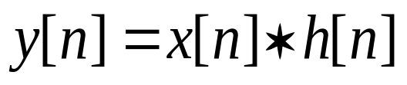
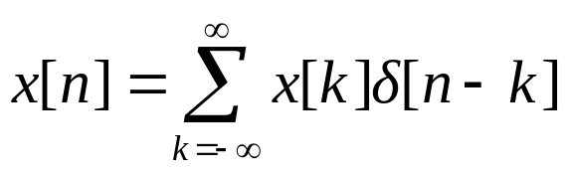
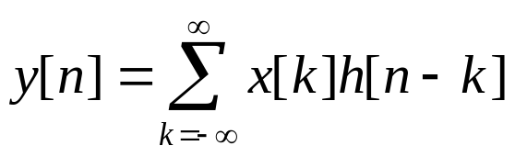
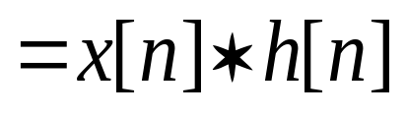
2.1 Discrete-Time LTI Systems: The Convolution Sum
4/43
2.1.1 What is the Convolution Sum?
h[n]
δ[n] → h[n]
Unit impulse response
h[n]
x[n]
y[n]=?
h[n] can completely characterize LTI system !
Step 1: Decomposing x[n]:
Step 2: From linearity and time-invariance property, we can write:
convolution sum
Notes:
1、卷积和本身是一种数学运算，在系统分析背景下，卷积和的意义是什么？
2、猛地用手击打桌面，模拟短暂激励，不同人有不同反映---说明 h 完全表征系统！

Slide 5
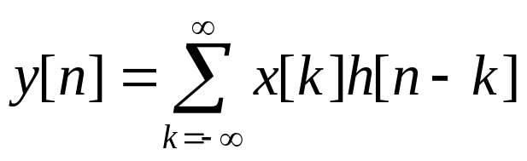
2.1 Discrete-Time LTI Systems: The Convolution Sum
5/43
2.1.2 How to calculate the Convolution Sum?
Example 2.1 (Method 1: Graphical Method)
Consider an LTI system with unit sample response h[n] and input x[n], as illustrated in Figure (a). Calculate the convolution sum of these two sequences graphically.
x[n]
h[n]
1
1
0.5
n
n
0 1 2
-2 0 2
(a)
x[k]
h[-k]
h[2]
h[-2]
k
k
0 1 2
-2 0 2

Slide 6
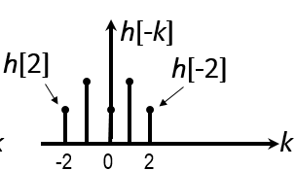
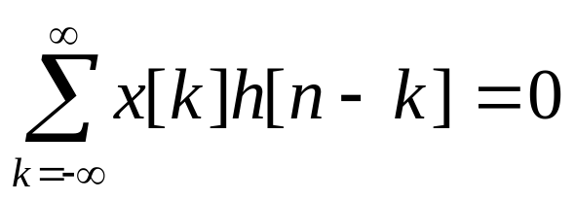
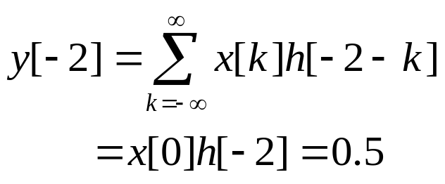
2.1 Discrete-Time LTI Systems: The Convolution Sum
6/43
x[k]
k
For n<-2
0 1 2
h[n−k]
k
n-2 n+2
For n= −2,
h[−2 −k]
h[2]
h[-2]
k
-4 -1 0

Slide 7
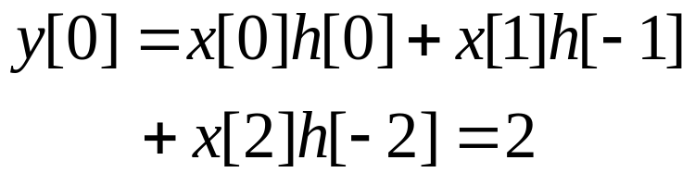
2.1 Discrete-Time LTI Systems: The Convolution Sum
7/43
x[k]
k
0 1 2
For n= −1,
h[−1− k]
-3 0 1
k
For n = 0,
h[0 − k]
-2 0 2
k

Slide 8
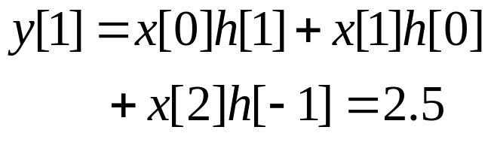
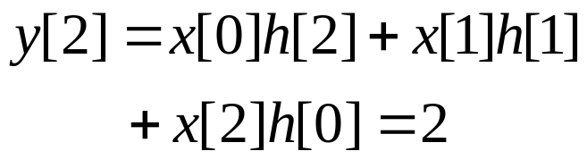
2.1 Discrete-Time LTI Systems: The Convolution Sum
8/43
x[k]
k
0 1 2
For n = 1,
h[1− k]
k
-1 0 3
For n = 2,
h[2 − k]
k
0 2 4

Slide 9

2.1 Discrete-Time LTI Systems: The Convolution Sum
9/43
x[k]
k
0 1 2
h[3− k]
For n = 3,
k
1 3 5
For n = 4,
h[4−k]
k
0 2 3 4 5 6

Slide 10
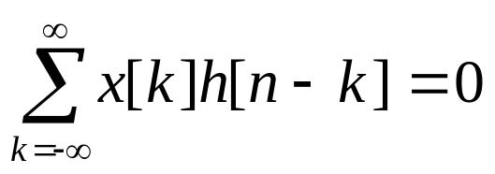
2.1 Discrete-Time LTI Systems: The Convolution Sum
10/43
For n>4,
h[n - k]
k
0 n-2 n n+2
y[n]
2.5
2
1.5
0.5
n
-2 -1 0 1 2 3 4

Slide 11
2.1 Discrete-Time LTI Systems: The Convolution Sum
11/43
Method 2: (Table Method)
h[n]
x[n] h[-2] h[-1] h[0] h[1] h[2] …
y[-2]
y[-1]
y[0]
y[1]
y[2]
y[3]
y[4]
x[0]
x[0]h[-2] x[0]h[-1] x[0]h[0] x[0]h[1] x[0]h[2] 0 0
x[1]
x[1]h[-2] x[1]h[-1] x[1]h[0] x[1]h[1] x[1]h[2] 0 0
x[2]
x[2]h[-2] x[2]h[-1] x[2]h[0] x[2]h[1] x[2]h[2] 0 0
：
0 0 0 0 0 0 0
Method 3: Multiplying if two sequences are short.
x[n] = {1,1,1}₀
0.5 1 0.5 1 0.5
1 1 1
0.5 1 0.5 1 0.5
+
h[n] = {0.5, 1, 0.5, 1, 0.5}₋₂
0.5 1 0.5 1 0.5
x[n]*h[n] = {0.5,1.5,2,2.5,2,1.5,0.5}₋₂
+
0.5 1 0.5 1 0.5
0.5 1.5 2 2.5 2 1.5 0.5

Slide 12

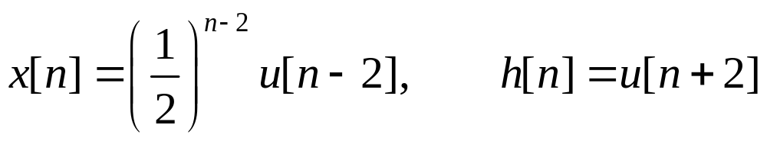
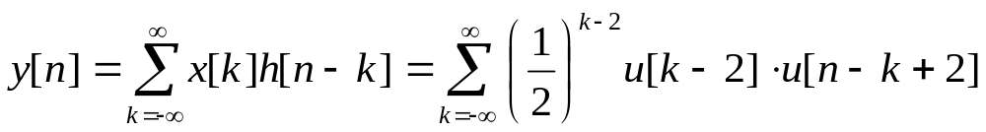
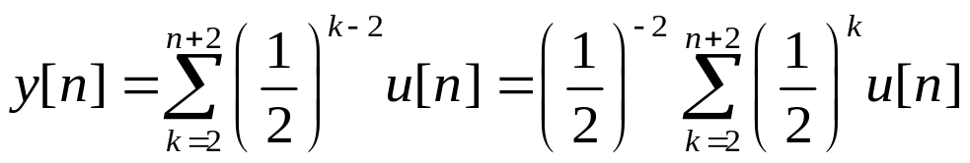
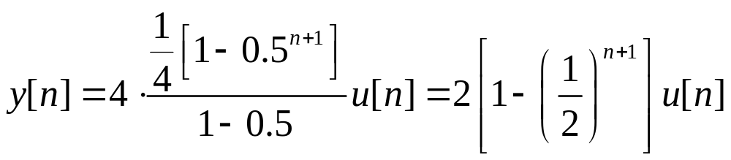
2.1 Discrete-Time LTI Systems: The Convolution Sum
12/43
Method 4: ( Definition )
Example 2.2
y[n]
Determine and plot the output where input x[n] and unit sample response h[n] given by
2
Sol: By definition
1
…
n
From the geometric sum formula,

Slide 13


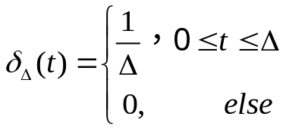

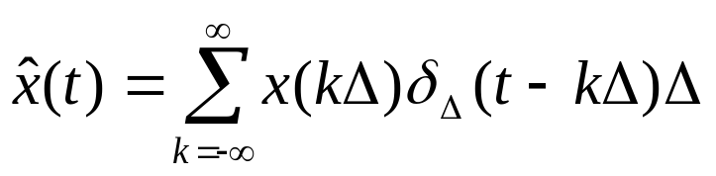
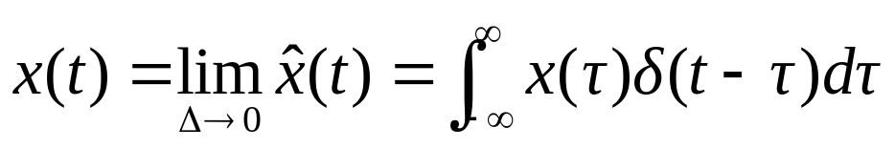
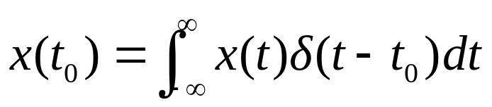
2.2 Continuous-Time LTI Systems: The Convolution Integral
13/43
2.2.1 What is the Convolution Integral?
h(t)
δ(t) → h(t)
Unit impulse response
h(t)
x(t)
y(t)=?
Step 1: Representing x(t) in terms of impulses (Decomposing):
x(t)
x(t)
x(t)
┉
┉
┉
t
t
t
-3Δ 0 2Δ kΔ
Staircase approximation to x(t)
Comparing with the Sampling property of δ(t):

Slide 14
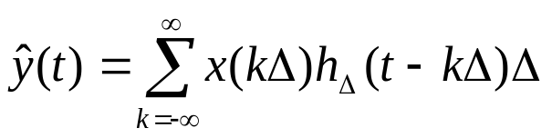


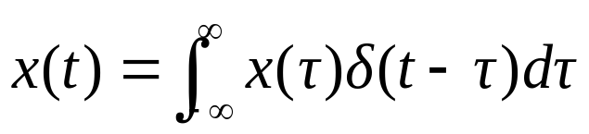
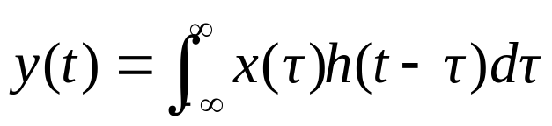
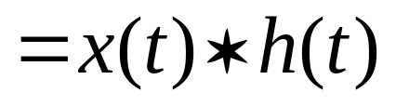
2.2 Continuous-Time LTI Systems: The Convolution Integral
14/43
h(t)
convolution integral
unit impulse response h(t) can completely characterize continuous-time LTI systems.

Slide 15
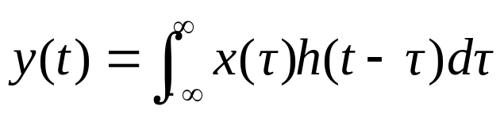



2.2 Continuous-Time LTI Systems: The Convolution Integral
15/43
2.2.2 How to calculate the Convolution Integral?
Example 2.3 (Method 1: Graphical Method)
Compute the convolution of the following two signals in Figure (a).
x(t)
h(t)
1
2T
t
t
0 T
(a)
0 2T
For t < 0
h(t–τ)
2T
1
x(τ)
τ
t-2T t 0 T
Interval 1. For t < 0, there is no overlap between the nonzero portions of
and
, and consequently,

Slide 16
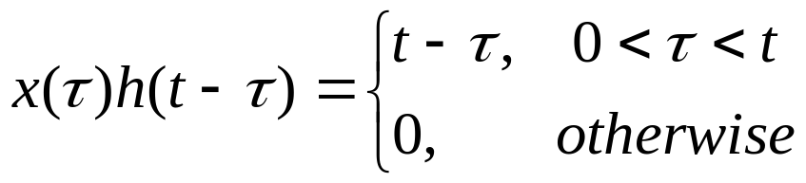
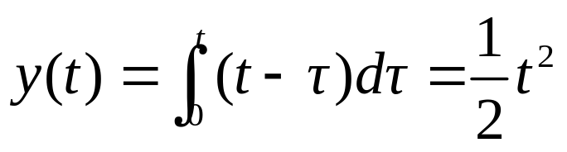
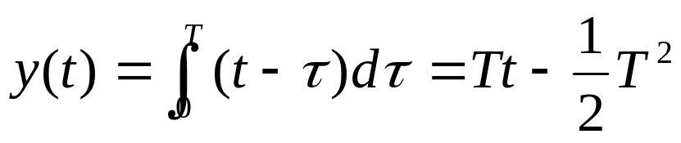
2.2 Continuous-Time LTI Systems: The Convolution Integral
16/43
h(t–τ)
2T
h(t–τ)
2T
For 0 < t < T
1
1
x(τ)
x(τ)
For T < t < 2T
τ
τ
t-2T 0 t T
t-2T T t
Interval 2. For 0 < t < T,
Interval 3. For T < t <2T,

Slide 17
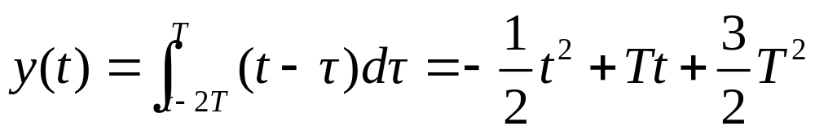
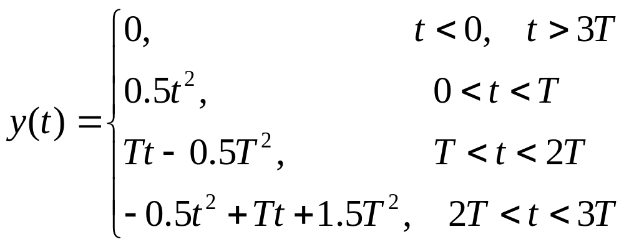
2.2 Continuous-Time LTI Systems: The Convolution Integral
17/43
2T
h(t–τ)
2T
h(t–τ)
x(τ)
For 2T < t < 3T
1
For t > 3T
1
x(τ)
τ
τ
t-2T t
0 T t-2T t
Interval 4. For 2T < t < 3T
Interval 5. For t > 3T, there is no overlap between the nonzero portions of and , hence, y(t) = 0.
Summarizing,

Slide 18
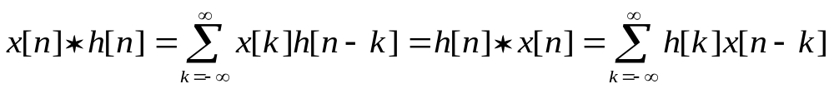
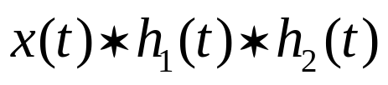

2.3 Properties of Linear Time-Invariant Systems
18/43
2.3.1 Properties of Convolution and Systems’ Construction
The Commutative Property (交换律)
The Distributive Property (分配律)
The Associative Property (结合律)

Slide 19
2.3 Properties of Linear Time-Invariant Systems
19/43
y₁(t)
h₁(t)
x(t)
y(t)
x(t)
h₁(t) + h₂(t)
y(t)
h₂(t)
y₂(t)
分配律：复杂系统可分解为简单系统之和！
Two equivalent systems: they having same impulse responses
x[n]
h₂[n]
y[n]
x[n]
h₁[n]
y[n]
h₁[n]
h₂[n]
x[n]
h[n]=h₁[n]*h₂[n]
y[n]
x[n]
h[n]=h₂[n]*h₁[n]
y[n]
Four equivalent systems

Slide 20
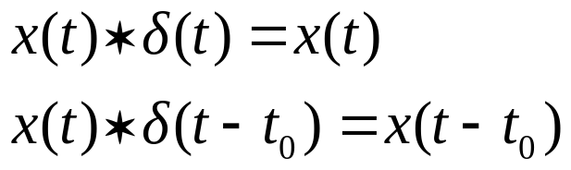
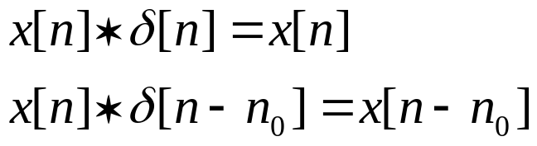
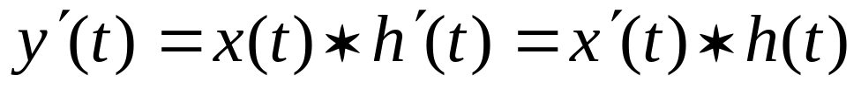
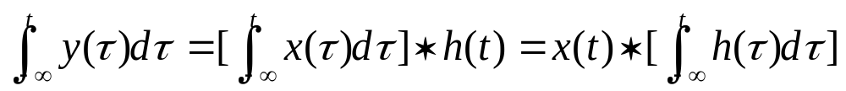
2.3 Properties of Linear Time-Invariant Systems
20/43
Convolving with Impulses
Differentiation and Integration of Convolution Integral
Combining the two properties leading to
Notes:
满足条件的函数才可这么用性质；在适合用的场合才用—例如微分产生冲激的情况44下

Slide 21
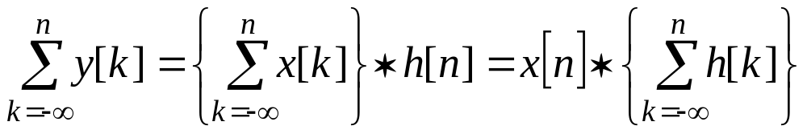
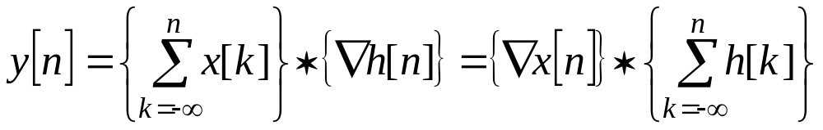
2.3 Properties of Linear Time-Invariant Systems
21/43
First Difference and Accumulation of Convolution Sum

Slide 22


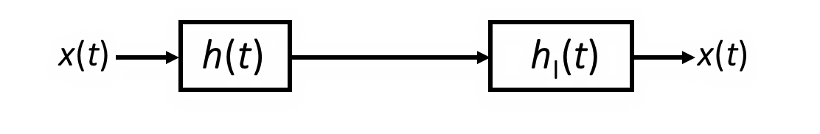

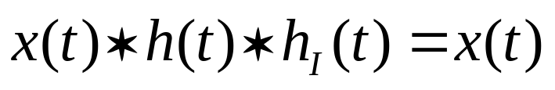
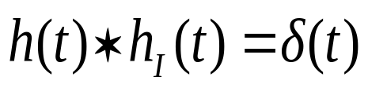
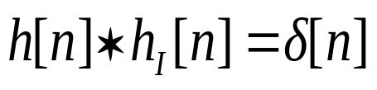
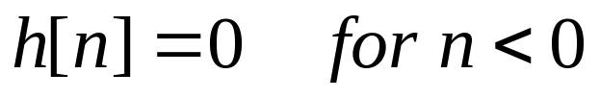
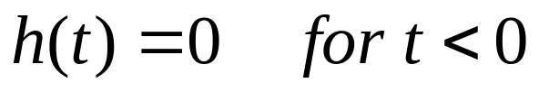
2.3 Properties of Linear Time-Invariant Systems
22/43
2.3.2 Relations between h(t)/h[n] and Properties of LTI Systems
LTI Systems with and without Memory
LTI systems without memory must have its impulse response
Invertible LTI Systems
Causal LTI Systems
Causal LTI systems must have its impulse response satisfying

Slide 23
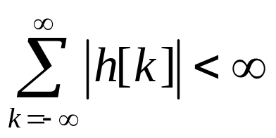
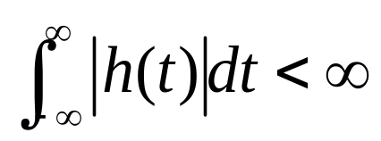
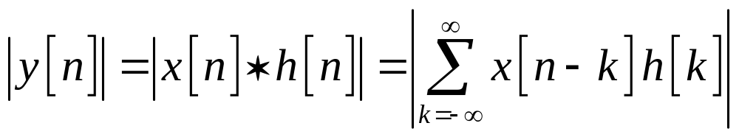
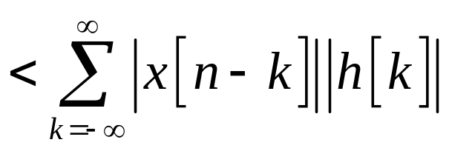
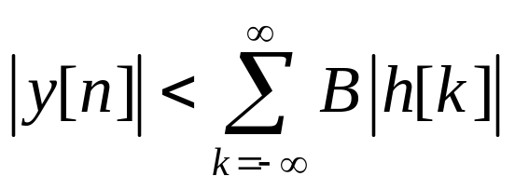
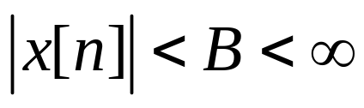


2.3 Properties of Linear Time-Invariant Systems
23/43
Stable LTI Systems
Stable LTI systems must have its impulse response satisfying
absolutely summable
absolutely integrable
Proof: (Sufficient condition)
Let
Then
If
Then
Therefore, the absolutely summable is a sufficient condition to guarantee the stability of a discrete-time LTI system.

Slide 24








2.3 Properties of Linear Time-Invariant Systems
24/43
(Necessary condition)
Let
, is conjugate complex of h[-n].
Obviously x[n] is bounded by 1, i.e. .
However,
If
Then
This showing that the absolutely summable is also a necessary condition.

Slide 25










2.3 Properties of Linear Time-Invariant Systems
25/43
2.3.3 The Unit Step Response s(t)/s[n] of an LTI System
（单位阶跃响应）
For a continuous-time LTI system, s(t) is the integral of h(t). h(t) is the first derivative of s(t).
For a discrete-time LTI system, s[n] is the sum of h[n]. h[n] is the first difference of s[n].

Slide 26





2.4 Causal LTI Systems Described By Differential and Difference Equations
26/43
2.4.1 Linear Constant-Coefficient Differential Equations (LCCDE)
Example 2.4
R
: input signal;
v_{s}(t)
+
-
C
i (t)
: output signal.
Linear constant-coefficient differential equation is the mathematical representation of a continuous-time LTI system.
General Nth-order LCCDE:
Note: If v_{s}(t) is a causal signal and , the circuit can also be represented by above equation. In this case it is an Incrementally Linear system.

Slide 27



2.4 Causal LTI Systems Described By Differential and Difference Equations
27/43
2.4.2 Solutions to LCCDEs
One or more auxiliary conditions must be specified to solve a differential equation. For a causal LTI system, we will use the condition of initial rest (初始松弛), that is if x(t)=0 for t≤t₀, y(t) =0 for t≤t₀ and therefore for a Nth-order equation, the N initial conditions are
Classic solution:
Particular solution (特解)
homogeneous solution (齐次解)
Forced response (受迫响应)
Natural response (自然响应)
The second solution: Decomposing response by the reason leading to the part of outputs, i.e.,

Slide 28











2.4 Causal LTI Systems Described By Differential and Difference Equations
28/43
Example 2.4 (Continued) (Reviewing Classic Method)
Sol: Let R=4, C=1/2, and
Then ①
Obviously,
Since for t>0, so let
Taking x(t) and y_{p}(t) for t >0 into equation ① yields
Thus
So for t>0,
Taking use of the condition of initial rest, we get
Consequently,
or
for t>0

Slide 29


2.4 Causal LTI Systems Described By Differential and Difference Equations
29/43
2.4.3 Linear Constant-Coefficient Difference Equations (LCCDE)
Linear constant-coefficient difference equation is the mathematical representation of a discrete-time LTI system.
Example 2.5
Jack saves money every month and the interest rate of bank is α per month. He saves into the bank x[n] yuan at the beginning of the n^{th} month and y[n] is the deposits in his account of the n^{th} month (before the bank calculates the interest). Try to write a difference equation relating x[n] and y[n]. (For simplicity suppose he wouldn’t withdraw his money in bank.)
y[n] is consists of the sum of the following three parts:
Sol:
⑴ x[n] — saved at the beginning of the n^{th} month
⑵ y[n-1] — deposit of the (n-1)^{th} month
⑶ αy[n-1] — interest at the end of the (n-1)^{th} month
So
or

Slide 30

2.4 Causal LTI Systems Described By Differential and Difference Equations
30/43
Additionally,
For sequence x[n], its First forward difference (一阶前向差分) is defined as Δ x[n] = x[n+1] – x[n]
First backward difference (一阶后向差分) is defined as
x[n] = x[n] – x[n-1]
Analogously, Second forward difference can be constructed as
Δ²x[n] = Δ{Δx[n]}
= Δ x[n+1] – Δ x[n] = x[n+2]-2x[n+1]+x[n]
Second backward difference as
²x[n]= x[n] – x[n-1] = x[n]-2x[n-1]+x[n-2]
Δ
Δ
Δ
Notes:
∆ׄx[n]=V(后向差分符号) x[n+1]，即前向差分等于后向差分左移一位

Slide 31




2.4 Causal LTI Systems Described By Differential and Difference Equations
31/43
2.4.4 Solutions to LCCDEs
General Nth-order linear constant-coefficient difference equation:
For causal LTI systems, initial rest condition is that if x[n]=0 for n<n₀, y[n]=0 for n<n₀ and therefore for a Nth-order equation, the N initial conditions are
Classic solution:
Forced response
Natural response
Recursive method: (递归法)

Slide 32










2.4 Causal LTI Systems Described By Differential and Difference Equations
32/43
Example 2.6 (Classic Method)
Solve the difference equation with the initial condition y[0]=1.
Sol: The characteristic equation is ,
the root is a = –2.
So
, Let
Taking into the original equation yields
From the initial condition of y[0]=1, we have
Consequently,
Notes:
此方程并不表示LTI系统；齐次解的形式C α^{n}

Slide 33









2.4 Causal LTI Systems Described By Differential and Difference Equations
33/43
Example 2.7 (Recursive Method)
A first-order LTI system is represented by equation
Determine the output recursively with the condition of initial rest and
Sol: Rewrite the given difference equation as
Starting from initial condition, we can solve for successive values of y[n] for n≥1:
Considering y[n] =0 for n≤0, the solution is
Notes:
方程阶数高，输入信号函数形式复杂----都无法得到y[n]的闭合表达式

Slide 34










2.4 Causal LTI Systems Described By Differential and Difference Equations
34/43
2.4.5 Relationships between y_{p}, y_{h}, y_{zi} and y_{zs}
Example 2.8 (y(t) = y_{zi}(t) + y_{zs}(t))
A second-order causal LTI system is described by differential equation . Determine the response with initial conditions and input .
Sol: The roots of characteristic equation are a=−2 and a=−3, so
Plug in the initial conditions,
Solve for
Notes:
提醒学生注意此例已知条件不同于以前例子！

Slide 35






2.4 Causal LTI Systems Described By Differential and Difference Equations
35/43
The impulse response of this system is
Thus
Relation?
y_{h}
y_{zi}
y_{p}
y_{zs}
Natural response
forced response

Slide 36





2.4 Causal LTI Systems Described By Differential and Difference Equations
36/43
If applying y(t) = y_{h}(t) + y_{p}(t), then from the characteristic roots
and
Taking x(t) and y_{p}(t) for t >0 into input-output equation yields
Then
Finally plug in to find
Not given! Found by impulse balance
Notes:
黑板上给出求y’(0-)和y(0-)的过程，以及求h(t)的过程，同时说明h(t)是齐次解！完全表征系统！

Slide 37









2.4 Causal LTI Systems Described By Differential and Difference Equations
37/43
Example 2.9
Determine the h[n] of a causal LTI system described by
Sol: h[n] satisfies
with initial condition
It’s obvious that ①
From h[0] − 0.5h[−1] = 3δ[0] we have
Continuingly from h[1] − 0.5h[0] = 3δ[1] ,
Taking h[1] into equation ① yields
Thus ②
In fact, h[0] also satisfies equation ②, so we can write
Trying one more time by recursive method!
Notes:
再一次用离散系统说明h[n]是齐次解，能完全表征系统！与零输入响应、自由响应模式相同。

Slide 38

2.5 Block Diagram Representations of First-Order Systems Described By Differential and Difference Equations
38/43
2.5.1 Block Diagram Representations of Discrete-Time Systems
First-order difference equation :
addition
delay
multiplication
Three basic elements in block diagram (方框图) : adder (加法器), multiplier (乘法器)and delayer (延时器).
x₂[n]
x[n]
a
ax[n]
x₁[n]
(b)
+
x₁[n]+x₂[n]
x[n]
x[n-1]
(a)
D
(c)
Basic elements for the block diagram representation of causal discrete-time systems: (a) an adder;(b) a multiplier;(c) a delayer.

Slide 39

2.5 Block Diagram Representations of First-Order Systems Described By Differential and Difference Equations
39/43
Steps to draw the block diagram of causal system represented by first-order difference equation
b
b
b
x[n]
y[n]
x[n]
+
y[n]
x[n]
+
+
y[n]
+
D
D
-a
y[n-1]
y[n-1]

Slide 40


2.5 Block Diagram Representations of First-Order Systems Described By Differential and Difference Equations
40/43
2.5.2 Block Diagram Representations of Continuous-Time Systems
First-order Differential equation :
differentiation
addition
multiplication
Three basic elements in block diagram are adder, multiplier and integrator (积分器).
x(t)
∫
Block diagram representation of an integrator

Slide 41

2.5 Block Diagram Representations of First-Order Systems Described By Differential and Difference Equations
41/43
Steps to draw the block diagram of causal system represented by first-order differential equation
b
b
b
x(t)
x(t)
x(t)
y(t)
+
y(t)
+
+
∫
+
∫
-a

Slide 42
2.6 SUMMARY
42/43
A representation of an arbitrary signal as weighted sum/integral of shifted unit impulses;
Convolution sum / convolution integral representation for the response of a LTI system;
Properties including causality and stability of LTI system ;
Solutions to LCCDEs ;
Relationships between y_{h}, y_{p}, y_{zi} and y_{zs} ;
Understanding of initial conditions used to solve LCCDEs, like y(0₋), y(0₊) and initial rest.

Slide 43
Homework
43/43
2.21 (a) (c) 2.22 (a) (c) 2.23 2.24
2.28 (b) (e) (g) 2.29 (b) (e) (f)
2.31

